Slide 1
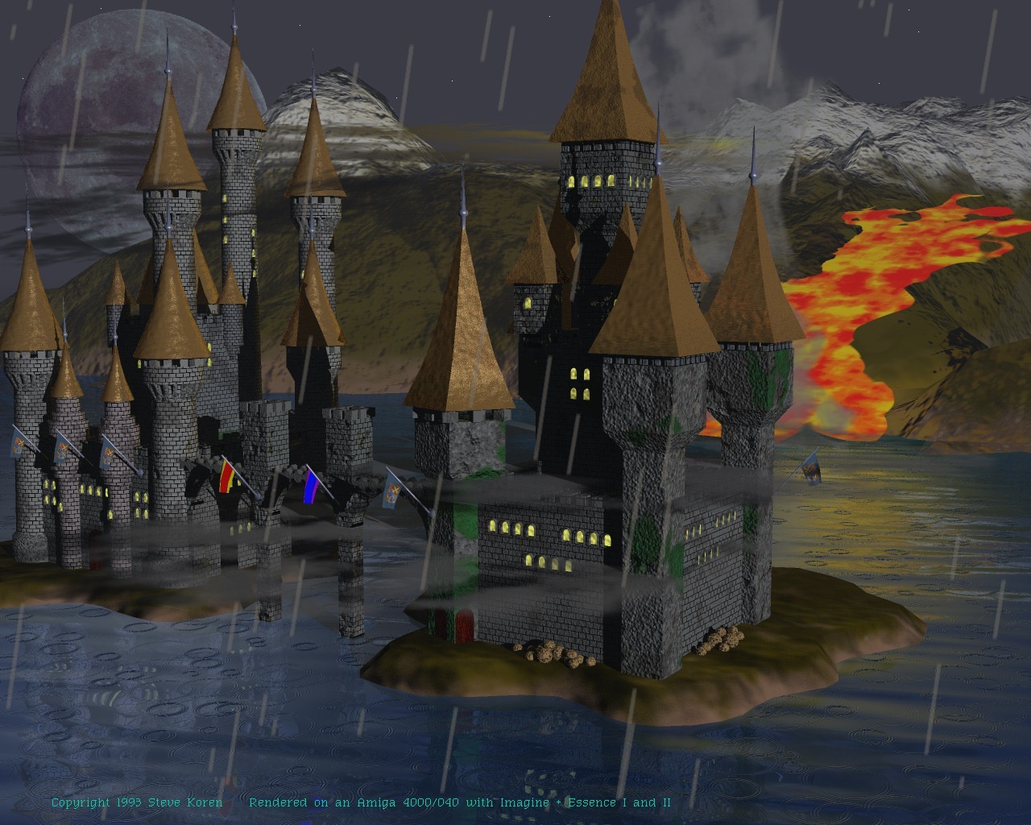
`
The Middle Ages (1066-1485)

Slide 2
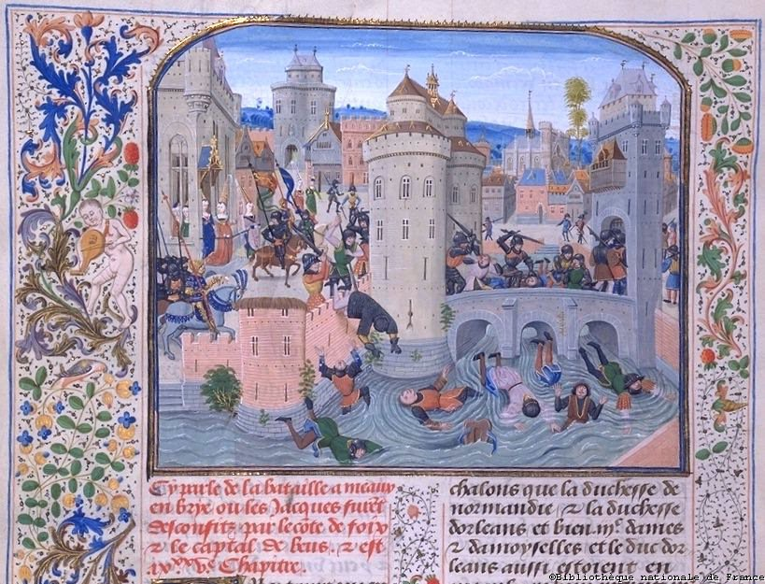
The Middle Ages
William the Conqueror and the Battle of Hastings
Feudalism and Knighthood
Women’s Roles
Chivalry and Courtly Love
City Classes
Crusades
Saint Thomas á Becket
The Magna Carta
The Hundred Years’ War
The Black Death

Slide 3
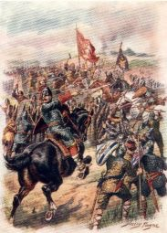
The Battle of Hastings
This battle took place in October, 1066.
Duke William (William the Conqueror) of Normandy, France, defeated and killed King Harold of England, the last of the Anglo-Saxon kings.
William seized the throne, claiming what he thought was rightfully his.
William did not want to eliminate Anglo-Saxon culture; instead, he wanted to simply rule them.
William ordered the Domesday book, an inventory of nearly every piece of property in England including land, cattle, and buildings.

Slide 4
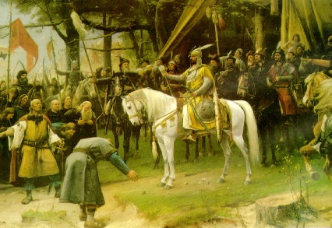
Feudalism and Knighthood
Feudalism – a social, caste, property, and military system that was based on a religious concept of hierarchy.
Feudalism ruled the Middle Ages.
Knights were near the top of the feudal hierarchy.
Knighthood was grounded in the feudal idea of loyalty and it entailed a complex system of social codes.

Slide 5
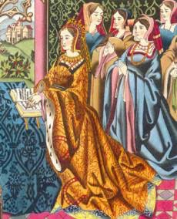
Women in Medieval Society
Since they were not soldiers, women had no political rights in a system that was primarily military.
A woman was always subservient to a man, whether husband, father, or brother.
Her husband’s or father’s social standing determined the degree of respect she commanded.
For peasant women, life consisted of childbearing, housework, and hard fieldwork.
For women of higher social standing, life consisted of childbearing and household management.

Slide 6
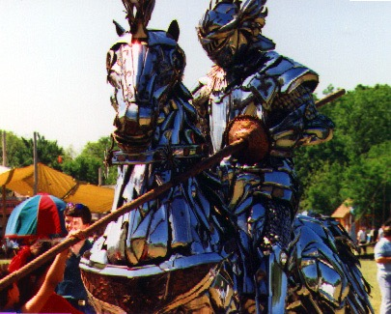
Chivalry and Courtly Love
Chivalry was a system of ideals and social codes governing the behavior of knights and gentlewomen.
Under chivalrous code, one must adhere to an oath of loyalty to the overlord and observing certain rules of warfare.
Adoring a particular lady was seen as a means of achieving self-improvement, also known as courtly love.
Practicing courtly love, a knight would wear a lady’s colors in battle, glorify her in words, and be inspired by her.
The lady, however, always remained pure and out of reach.
The most famous English romance is Sir Gawain and the Green Knight.

Slide 7
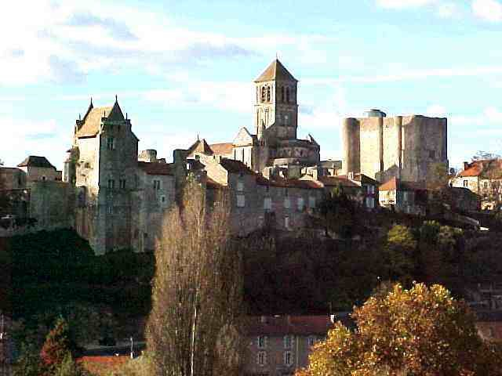
City Classes
The majority of medieval life centered around the feudal castle.
As the population grew, however, an increasing number of people lived in towns and cities.
Eventually, these cities and their enormous population would render the feudal system obsolete. Why?

Slide 8

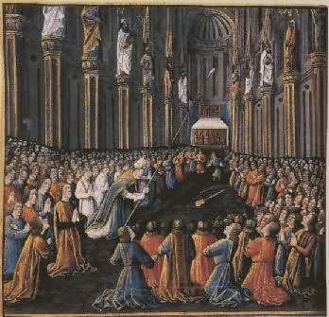
The Crusades
The Crusades were a series of wars waged by European Christians against Muslims, with Jerusalem and the Holy Land as a prize.
The Crusades provided Europeans the opportunity to trade ideas, providing for the lifestyle we see in Chaucer’s Canterbury Tales.

Slide 9
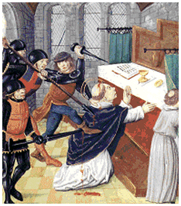
Saint Thomas á Becket
Being a trusted friend of King Henry II of England, Saint Thomas was appointed as Archbishop of Canterbury.
The King appointed Saint Thomas because he believed that he could use Thomas to rule the church as he wished.
However, Becket sided with the Pope more than with the King.
The King, in exasperation said, “Will no one rid me of this turbulent priest?”
Four of the King’s knights took his words literally and murdered Becket inside his own cathedral.
Saint Thomas á Becket is also known as Sir Thomas the Martyr.

Slide 10
City Classes
The majority of medieval life centered around the feudal castle.
As the population grew, however, an increasing number of people lived in towns and cities.
Eventually, these cities and their enormous population would render the feudal system obsolete. Why?

Slide 11
The majority of medieval life centered around the feudal castle.
As the population grew, however, an increasing number of people lived in towns and cities.
Eventually, these cities and their enormous population would render the feudal system obsolete. Why?

Slide 12
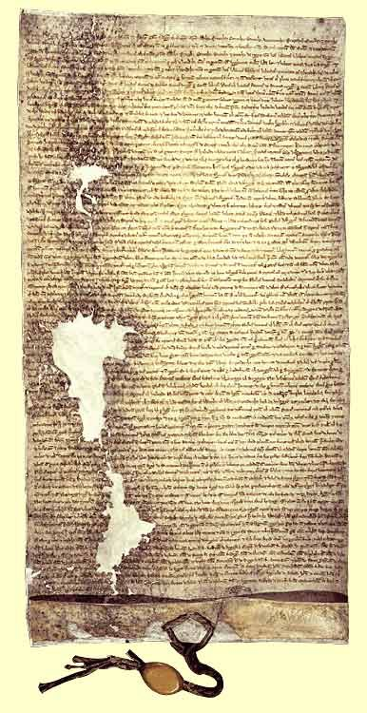

The Magna Carta
The Magna Carta was signed by King John in the year 1215 at Runnymede.
King John was forced to sign the document and the signing was a defeat for central papal (of the Pope) power.
Ultimately, the Magna Carta curbed the Church’s power.
The Magna Carta later became the basis for English constitutional law, in which such rights as trial by jury and legislative taxation were established.

Slide 13
The Magna Carta was signed by King John in the year 1215 at Runnymede.
King John was forced to sign the document and the signing was a defeat for central papal (of the Pope) power.
Ultimately, the Magna Carta curbed the Church’s power.
The Magna Carta later became the basis for English constitutional law, in which such rights as trial by jury and legislative taxation were established.

Slide 14
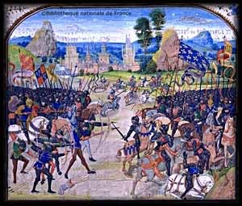
The Hundred Years’ War
This war might be called the first national war, waged by England against France and taking place between the years 1337 and 1453.
The war concerned issues involving English kings pursuing the French throne.
The war was unsuccessful for the English.
However, after the War, England was not known by its knights but instead its yeomen (small landowners).

Slide 15
This war might be called the first national war, waged by England against France and taking place between the years 1337 and 1453.
The war concerned issues involving English kings pursuing the French throne.
The war was unsuccessful for the English.
However, after the War, England was not known by its knights but instead its yeomen (small landowners).

Slide 16
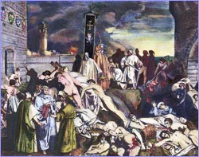
The Black Death
Also known as the Bubonic Plague, the Black Death struck England between the years 1348 and 1349.
The plague was highly contagious and spread by fleas of infected rats.
The Black Death reduced England’s population by one-third.
The results of the Black Death include freedom for the serfs and the end of feudalism.

Slide 17
Also known as the Bubonic Plague, the Black Death struck England between the years 1348 and 1349.
The plague was highly contagious and spread by fleas of infected rats.
The Black Death reduced England’s population by one-third.
The results of the Black Death include freedom for the serfs and the end of feudalism.

